Slide 1
Secure Confidential Document Storage Box with Tamper Detection using Arduino Uno
PBCST504 – MICROCONTROLLERS
MICRO PROJECT
Zeroth Review
Dept Of CSE(CY)

Slide 2
Title:-Secure Confidential Document Storage Box with Tamper Detection using Arduino Uno
Secure Confidential Document Storage Box with Tamper Detection using Arduino Uno
Group No:13 Members:
ASHIK BENNY-JEC24CC024
FATHIMA SHADIYA M-JEC24CC030 KISHAN US-JEC24CC042 PARIKSHITH SUSHIL-JEC24CC048 SRUTHI R-JEC24CC057
Project Coordinator:
Ms.Sagna L T
Asst. Prof. CSE(CY)
Dept Of CSE(CY)

Slide 3
DEPARTMENT OF COMPUTER SCIENCE & ENGINEERING
(Cyber Security)
Vision of the Department
To be a globally recognized centre of excellence in Cyber Security education, research and innovation by nurturing ethical professionals , fostering technological advancement through responsible practice and contributing to a secure and sustainable digital society.

Slide 4

DEPARTMENT OF COMPUTER SCIENCE & ENGINEERING
(Cyber Security) Mission of the Department
M1: Excellence in Education : To provide outcome-based and industry-oriented education by integrating core computer science principles with advanced cybersecurity technologies and practices.
M2: Ethics and Professional Responsibility : To cultivate ethical values, integrity, social responsibility, and secure computing practices for protecting digital assets and strengthening cyber trust.
M3: Research, Innovation, and Entrepreneurship : To promote research, innovation, and entrepreneurial thinking for developing sustainable solutions to emerging cybersecurity challenges.
M4: Holistic and Global Development : To enhance leadership, teamwork, lifelong learning, and global
competence through industry collaboration, interdisciplinary activities, and community engagement.

Slide 5
Programme Educational Objectives (PEOs)
PEO 1: Graduates will apply strong foundations in computer science and cybersecurity to design, develop, and manage secure and reliable computing systems for industry and society.
PEO 2: Graduates will pursue successful careers as professionals, innovators or entrepreneurs engaged in technology development, deployment or engineering system implementation in industry and society and contribute to the economic growth of the country.
PEO 3: Graduates will demonstrate ethical responsibility, leadership, teamwork, and effective communication while adapting to evolving global technological environments through lifelong learning.

Slide 6
Programme Outcomes
Engineering Graduates will be able to:
Engineering knowledge: Apply the knowledge of mathematics, science, engineering fundamentals, and an engineering specialization to the solution of complex engineering problems.
Problem analysis: Identify, formulate, review research literature, and analyze complex engineering problems reaching substantiated conclusions using first principles of mathematics, natural sciences, and engineering sciences.
Design/development of solutions: Design solutions for complex engineering problems and design system components or processes that meet the specified needs with appropriate consideration for the public health and safety, and the cultural, societal, and environmental considerations.
Conduct investigations of complex problems: Use research-based knowledge and research methods including design of experiments,
analysis and interpretation of data, and synthesis of the information to provide valid conclusions.
Modern tool usage: Create, select, and apply appropriate techniques, resources, and modern engineering and IT tools including prediction and modeling to complex engineering activities with an understanding of the limitations.

Slide 7
The engineer and society: Apply reasoning informed by the contextual knowledge to assess societal, health, safety, legal and cultural issues and the consequent responsibilities relevant to the professional engineering practice.
Environment and sustainability: Understand the impact of the professional engineering solutions in societal and environmental contexts, and demonstrate the knowledge of, and need for sustainable development.
Ethics: Apply ethical principles and commit to professional ethics and responsibilities and norms of the engineering practice.
Individual and team work: Function effectively as an individual, and as a member or leader in diverse teams, and in multidisciplinary settings.
Communication: Communicate effectively on complex engineering activities with the engineering community and with society at large, such as, being able to comprehend and write effective reports and design documentation, make effective presentations, and give and receive clear instructions.
Project management and finance: Demonstrate knowledge and understanding of the engineering and management principles and apply these to one’s
own work, as a member and leader in a team, to manage projects and in multidisciplinary environments.
Life-long learning: Recognize the need for, and have the preparation and ability to engage in independent and life-long learning in the broadest context of
technological change.
Dept Of CSE(CY)

Slide 8
Programme Specific Outcomes (PSOs)
On the completion of Computer Science & Engineering program, the students will possess:
PSO 1: Apply cyber security principles to mitigate cyber risk and analyze security requirements of an organization.
PSO 2: Develop and deploy secure software and infrastructure using modern tools and industry standards.
PSO 3: Uphold ethical, legal, and societal responsibilities while protecting privacy, data, and digital assets.

Slide 9
CONTENTS
Motivation
Introduction
Problem Statement
Proposed Method
Basic Block Diagram
Conclusion
References

Slide 10
Motivation
Protect confidential documents from unauthorized access.
Improve security using RFID and password authentication.
Detect and alert users about tampering attempts.
Demonstrate practical cybersecurity concepts using Arduino Uno.
Develop a simple, low-cost, and reliable security system.

Slide 11
Introduction
Secure Confidential Document Storage Box with Tamper Detection using Arduino Uno
Arduino Uno–based security system for protecting confidential documents.
Uses RFID card and password for secure user authentication.
Servo motor locks and unlocks the storage box.
Tamper detection switch identifies unauthorized opening attempts.
Buzzer, LEDs, and LCD provide security alerts and system status.
Demonstrates cybersecurity concepts such as authentication, access control, physical security, and tamper detection.
Developed using the Arduino IDE with low-cost, easily available components.

Slide 12
Problem Statement
Secure Confidential Document Storage Box with Tamper Detection using Arduino Uno
Confidential documents are vulnerable to unauthorized access and theft.
Traditional lock-and-key systems provide limited security and can be easily compromised.
There is no immediate alert when someone attempts to force open a storage box.
A secure, low-cost, and easy-to-use document protection system is needed.
The system should restrict access to authorized users and detect tampering attempts in real time.
Existing storage systems lack integrated authentication and tamper detection, reducing the overall security of confidential documents.

Slide 13
Proposed Method
Design a secure document storage box using Arduino Uno.
Authenticate users using an RFID card and a password.
Control the box lock and unlock mechanism using a servo motor.
Continuously monitor the box using a tamper switch to detect unauthorized access.
Trigger a buzzer, warning LED, and LCD alert when tampering is detected.
Allow only authorized users to reset the system and regain access.
Verify user identity before granting access to the stored documents.
Prevent unauthorized access by keeping the box locked during security violations.
Enhance document security by combining authentication with real-time tamper detection.

Slide 14
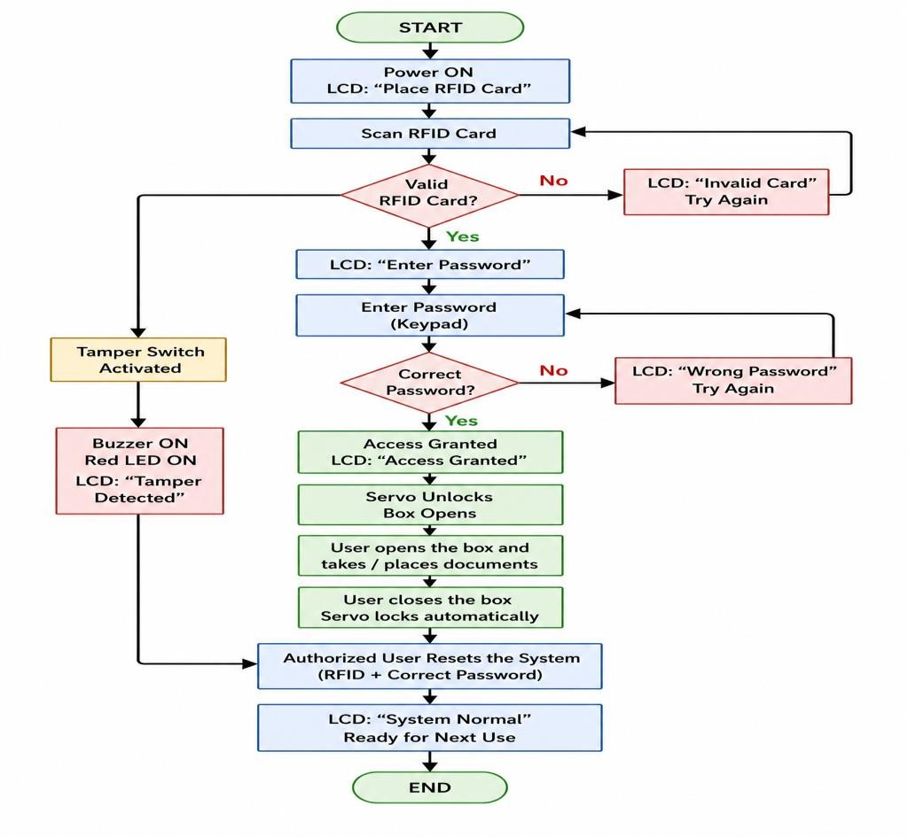
Basic Block Diagram

Slide 15

Conclusion
Successfully developed a secure document storage system using Arduino Uno.
Enhanced security through RFID and password-based authentication.
Detected unauthorized access using a tamper detection mechanism.
Provided real-time alerts using a buzzer, LEDs, and LCD display.
Demonstrated practical cybersecurity concepts with a low-cost and beginner-friendly solution.
The project is easy to implement, cost-effective, and suitable for educational and office applications.
The system can be further enhanced by integrating Wi-Fi alerts, fingerprint
authentication, or cloud-based monitoring.

Slide 16
References
Arduino Official Documentation – https://docs.arduino.cc/
Arduino IDE Documentation – https://docs.arduino.cc/software/ide/
MFRC522 RFID Library (GitHub)
Arduino Servo Library Documentation

